Slide 1
SCHIZOPHRENIA
Mugambi James

Slide 2
OBJECTIVES
Description of the syndrome
Epidemiology, etiology and pathophysiological mechanisms
Management – psychopharmacology and cognitive behavioral approaches

Slide 3
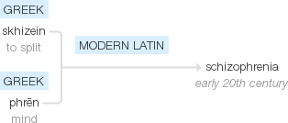
Origin

Slide 4
Definition
A spectrum of disorders characterized by severely impaired cognitive processes , personality disintegration, affective disturbances and social withdrawal.
Schizophrenia occurs in:
All races
All cultures
All social classes
Both sexes

Slide 5
HISTORY
The ancient Greek and Roman literature showed that although the general population probably had an awareness of psychotic disorders,there was no condition that would meet the modern diagnostic criteria for schizophrenia in these societies.
Early theories supposed that mental disorders were caused by evil possession of the body, and the appropriate treatment was then exorcising these demons, through various means (music, drilling holes)

Slide 6
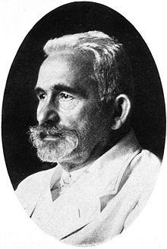
HISTORY
Dr. Emile Kraepelin (1856- 1926)
Believed the chief origin of psychiatric disease to be biological and genetic malfunction.
“Dementia praecox" (early dementia) – 1893
Kraepelin is specifically credited with the classification of the unitary concept of psychosis, into two distinct forms (Kraepelinian dichotomy):
Dementis praecox.
Manic depression.

Slide 7
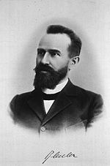
HISTORY
Dr. Eugen Bleuler (1857 – 1939)
Coined the term, "schizophrenia" in 1911.
The first to describe the symptoms as "positive" or "negative."
Eugen Bleuler—4 A’s
Disturbance of Associations —Thought disorder.
Affective blunting — Inappropriate emotional response.
Ambivalence — holding of conflicting attitudes and emotions towards others and self
Autism —social withdrawal- preferring to live in a fantasy world rather than interact with the social world appropriately.
Notes:
Bleuler changed the name to schizophrenia as it was obvious that Krapelin's name was misleading as the illness was not a dementia (it did not always lead to mental deterioration) and could sometimes occur late as well as early in life.
By ‘splitting', Bleuler meant:-
(a) a deep and general ‘primary loosening of associational networks', leading to irregular breaking of ‘concrete concepts'

Slide 8
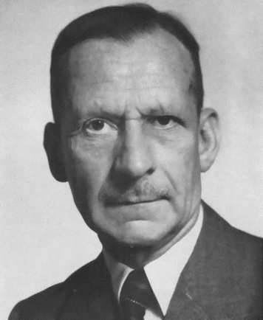
HISTORY
Kurt Schneider (1887 -1967)
First-rank symptoms
ABCD:
Auditory hallucinations (3rd person)
Broadcasting of thought
Controlled thought (delusions of control)
Delusional perception.

Slide 9
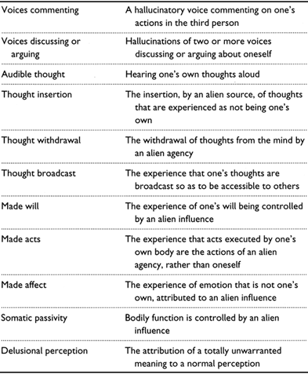
Schneiderian first-rank symptoms

Slide 10
Epidemiology
Lifetime prevalence 0.3%-0.7% of population world wide (variation race , ethnicity, geographical origin e.t.c.)
Males = females
Females have later onset , better functional outcome and
display a bimodal age distribution
Onset :- male (10-25 years)
female (1st peak 25-35yrs ,2nd peak >40yrs)

Slide 11
ETIOLOGY
The specific etiology of schizophrenia is not known. Its origin is thought to be multifactorial:
Genetics factors
Biochemical factors
Neuropathology

Slide 12
Genetics
Highly heritable
Risk increases with relationship e.g. 10% for 1st degree relative or fraternal twin, 50% concordance for monozygotic twin
Environmental factors certain but poorly characterized (season of birth , intrauterine malnutrition, viral illness, perinatal insults, drug exposure)

Slide 13
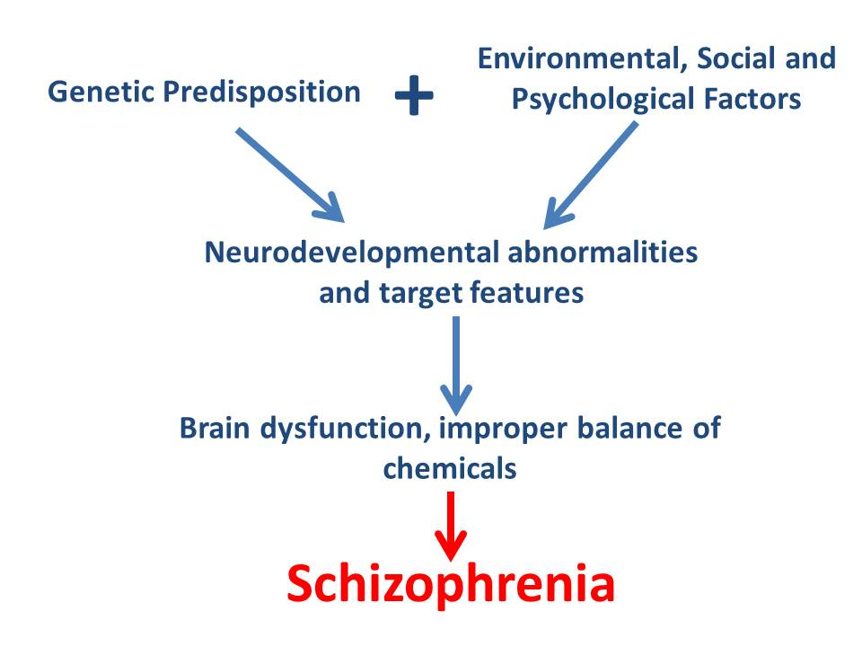

Slide 14
Genetics
Like most medical disorders non- mendelian, multiple risk genes of small effect and variable penetrance
Recent advances shows that, a number of candidate genes are involved in a range of neurodevelopmental and neuromodulatory processes
Opens the possibility for understanding molecular pathways to schizophrenia and for screening and intervention

Slide 15
Biochemical factors
Dopamine hypothesis (influential)
The classical dopamine hypothesis (too much dopamine in schizophrenia) rested on the observation that DA releasing drugs can cause psychosis and the discovery that antipsychotics were dopamine antagonists.
Increased subcortical DA related to psychosis
Decreased prefrontal DA related to impaired cognition
Decreased prefrontal activity ( DA based or otherwise) may lead to subcortical DA dysregulation and psychosis

Slide 16
Dopamine Theory
of Schizophrenia
Hyperdopaminergic
pathways
Hypodopaminergic
pathways
Positive symptoms
Negative symptoms

Slide 17
Biochemical factors
Serotonin hypothesis
It has been shown that serotonin excess results in both positive and negative symptoms.
The robust serotonin antagonist activity of clozapine and other 2nd generation antipsychotics to decrease positive symptoms in chronic patients has contributed to the validity of this preposition.

Slide 18
Neuropathology
Neurodevelopmental model supposes that in schizophrenia there is a “silent lesion” in the brain,
It does not interfere too much with the basic brain functioning in early years, but expresses itself in the time, when the subject is stressed.

Slide 19
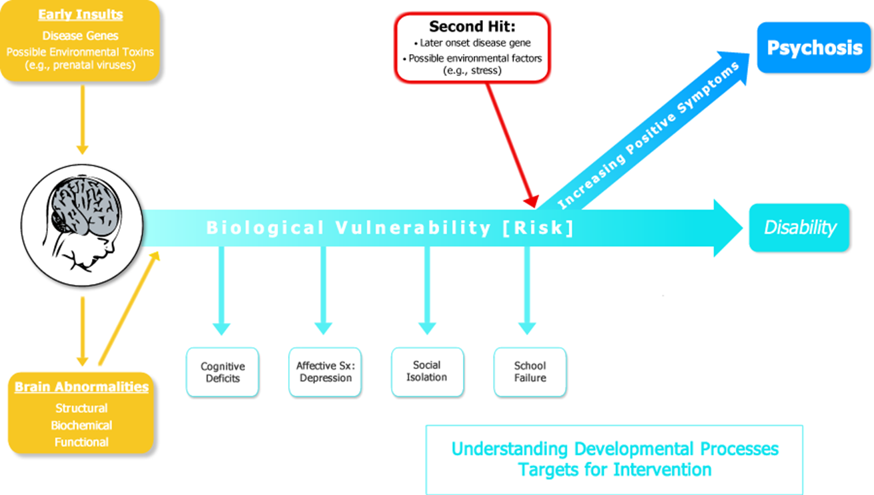
Neurodevelopment and schizophrenia

Slide 20
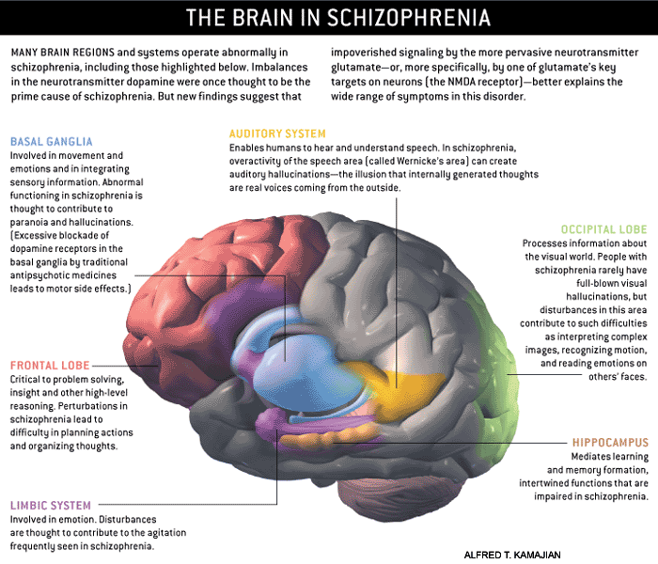

Slide 21
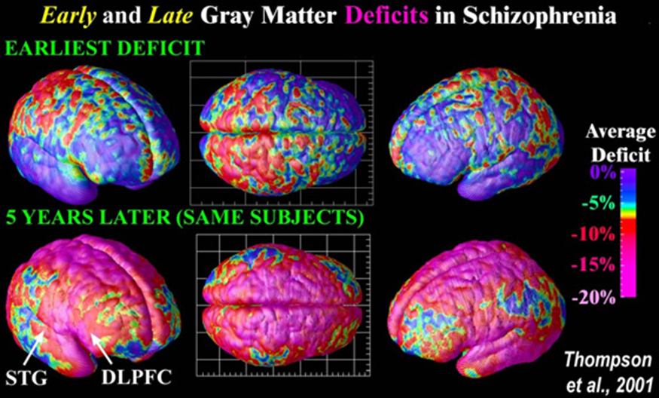
Gross structural changes in the brain
Regional reductions, pre-frontal cortex, superior temporal gyrus , hippocampus

Slide 22
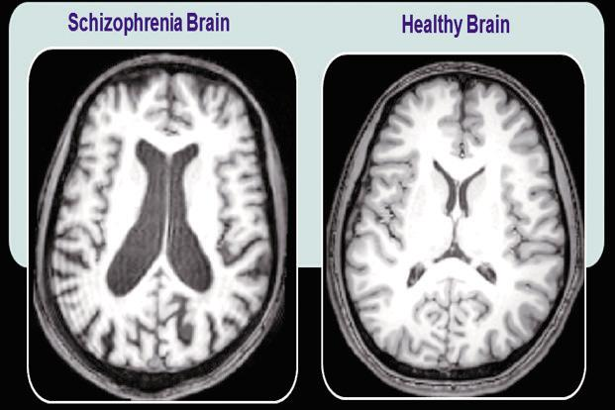

Slide 23
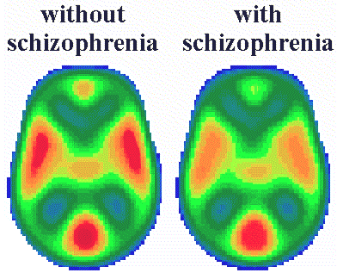
Positron emission tomography (PET scan) that measures brain metabolic rate of glucose and cerebral blood flow can detect different patterns in normal and schizophrenic patients. The left image is that of the control; the right image revealing decreased metabolism in the temporal lobes is that of a schizophrenic patient. Furman University

Slide 24
Diagnostic criteria (DSM V)
Two (or more) of the following, each present for a significant portion of time during 1 month period. At least one of these must be (1),(2) or (3) :-
Active – phase symptoms
Hallucinations.
Delusions.
Disorganized speech (e.g. frequent derailment or incoherence).
Grossly disorganized or catatonic behavior.
Negative – passivity , avolition , blunted affect.

Slide 25
Diagnostic criteria (DSM V)
Minimum duration of 6 months of continuous signs of illness associated with functional decline.
All other differentials should be ruled out.
The disturbance should not be attributed to a substance (drug abuse or medication)
If there is history of autism spectrum disorder or communication disorder of childhood onset , the additional diagnosis of schizophrenia is made only if the patients symptoms fit the above mentioned criteria.

Slide 26
Diagnostic criteria (DSM V)
Only Specify the course after 1 year:
First episode, currently in acute episode.
First e episode, currently in partial remission.
First e episode, currently in full remission.
Multiple episodes, currently in acute episode.
Multiple episode, currently in partial remission.
Multiple episode, currently in full remission.
Continuous.
Unspecified.

Slide 27
Diagnostic criteria (DSM V)
Specify if with catatonia
Specify the current severity ……

Slide 28
Investigations
NO gold standard test
Screen for drugs of abuse (urine)
Bloods for fbc, biochemistry, blood glucose, TFTs, TPHA and VDRL
EEG
ECG
CT and MRI brain

Slide 29
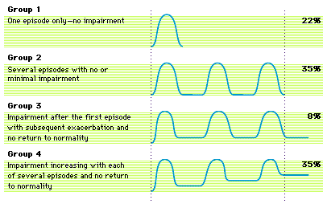
Course of schizophrenia
After 10 years, of the people diagnosed with schizophrenia:
20% Completely Recover
25% Much Improved, relatively independent
30% Improved, but require extensive support network
15% Hospitalized, unimproved
10% Dead (Mostly Suicide)

Slide 30
Good prognostic factors
      Female
      Older age of onset
      Married
      Living in a developing (as opposed to developed) country
      Good premorbid personality
      No previous psych history
      Good education and employment record
      Acute onset, affective symptoms, good compliance with meds

Slide 31
Poor prognostic factors
Early age of onset
Male sex
Lower educational achievements
More prominent negative symptoms
More prominent cognitive impairments

Slide 32
Comorbidity
High comorbidity with substance-related disorders (1/2 smoke cigarettes and tobacco)
Anxiety disorders
Increased rate of obsessive-compulsive disorder and panic disorder.
Schizotypal or paranoid personality disorder may sometimes precede the onset of schizophrenia.
80% of all persons with schizophrenia have significant concurrent medical illnesses (DM, CVS , pulmonary diseases e.t.c.)

Slide 33
Management
Early intervention important for improving functional outcome – psychoeducation and family involvement
Medication treatments
Psychosocial treatments

Slide 34
Antipsychotic medications
All are dopamine D2 receptor antagonists
First generation or typical medications
Have high affinity for D2
Extra pyramidal side effects (EPS), galactorrhoea and tardive dyskinesia common
Clozapine (old atypical) for treatment resistant patients
1% prevalence of agranulocytosis – hypersalivation and sedation can occur with the use of clozapine.

Slide 35
Antipsychotic medications
Second generation or atypical drugs – dopamine stabilizers)
Less EPS, less affective blunting, less depression/sedation, less cholinergic side effects
Highly variable side effects main factor in long term medication choice
Once daily dosing
Weight gain and impaired glucose tolerance

Slide 36
Summary of medication
Psychopharmacology of schizophrenia is effective
Side effects can be significant
Individual patient response is variable
Combine with antidepressants and mood stabilizers
Residual cognitive deficits
Respond poorly to current medications and Strongly predicts functional disability
ECT - Catatonic type

Slide 37
Psychosocial treatments
Education of parents and carers
Cognitive behavioral therapy
Individual psychotherapy
Insight orientation
supportive
Rehabilitation
Group psychotherapy

Slide 38
Psychosocial treatments
COGNITIVE- BEHAVIORAL THERAPY (CBT)
Techniques :-
modeling (learning by observing)
Assertiveness and social skills training
Emphasis on moving from unrealistic thoughts to realistic ones

Slide 39
Future directions in the treatment of schizophrenia
Much stronger focus on early intervention and prevention e.g. early psychosis clinics and prodromal studies
Specific treatments for cognition in schizophrenia
As molecular pathways associated with neural phenotypes become understood new, non dopamine based therapies
Renewed emphasis on rehabilitation

